Slide 1


#3 Random Forest
Deep Dive
by Saturdays.AI
Saturdays.AI Madrid
Machine Learning

Slide 2


Week 3
Schedule
State of the course
Session 3 Review
Challenge
Notebook + resources

Slide 3
Sesión 3
Agenda
9:30 - Lesson #3 + Work!
11:30 - Coffee Break ☕️
11: 45 - Keep Working! 🚀
13:30 - Talk: Moisés Martínez 🗣

Slide 4
State of the course
#1 Exploratory Data Analysis & Classification ✅
#2 Regression & Model Validation ✅
#3 Random Forest Deep Dive 🔴 Today!
#4 Unsupervised Learning 🔜
#5 Neural Networks, Gradient Descent 🔜
#6 NLP 🔜

Slide 5

¿Dudas?

Slide 6
Random Forest Deep Dive 🏊🏻‍♂️
Random Forest & Gradient Boosting
Bagging, Boosting & Out of Bag
Hyperparameter tunning
Feature Engineering
Classification vs Regression Evaluation

Slide 7

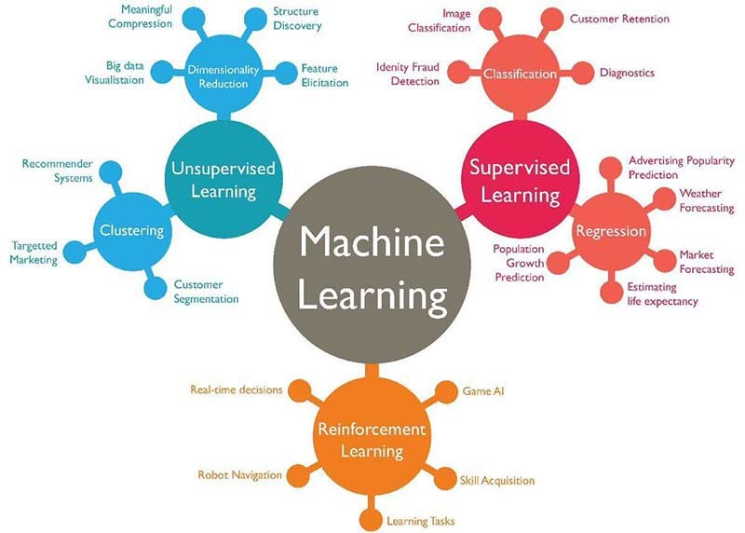
¿Where we are?
Categorical response variable
Classification problems
Linear response variables
Linear problems
Supervised Learning
Notes:
Jan

Slide 8

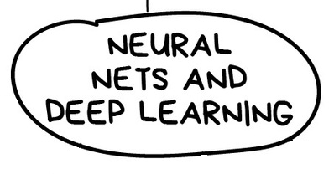
ML Algorithms

Slide 9
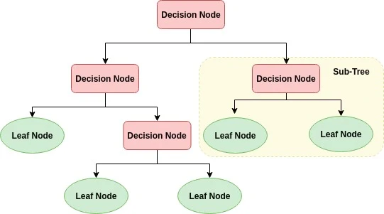
¿Remember? Decision Tree Algorithms
DEPTH OF TREE
Depth =1
Depth =2
Depth =3
Notes:
Esta la quito igual

Slide 10
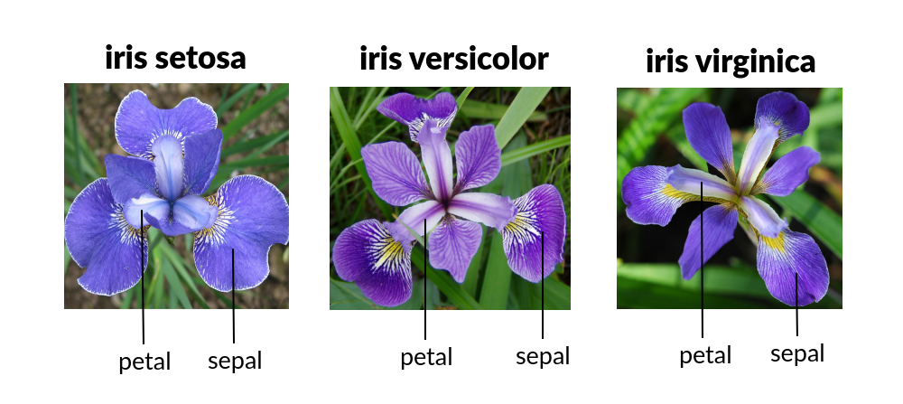
Decision Tree Algorithms
Notes:
Esta la quito igual

Slide 11
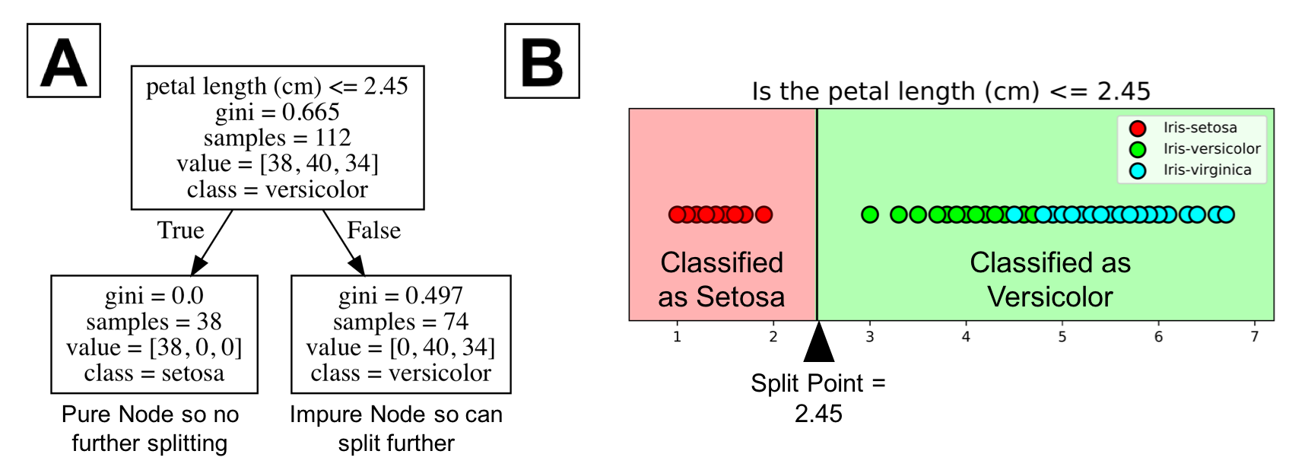
Decision Tree Algorithms
Notes:
Esta la quito igual

Slide 12
Random Forest
RANDOM FOREST:
The random forest is a model made up of many decision trees. Rather than just simply averaging the prediction of trees (which we could call a “forest”), this model uses two key concepts that gives it the name random:
Random sampling of training data points when building trees
Random subsets of features considered when splitting nodes
Lectures: berkeley.edu - Random forest - Key Concepts
Notes:
Esta la quito igual

Slide 13
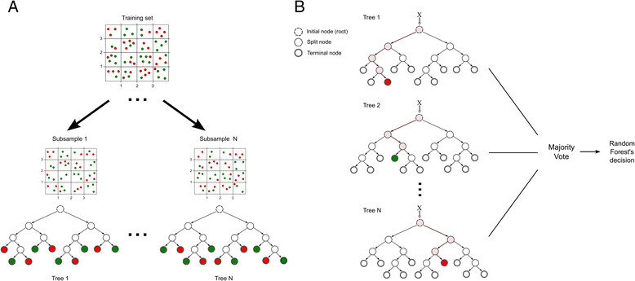
Random Forest: Random sampling of training data
Each tree in a random forest learns from a random sample of the data points.

Slide 14
Random Forest: Random sampling of training data
At test time, predictions are made by averaging the predictions of each decision tree.

Slide 15
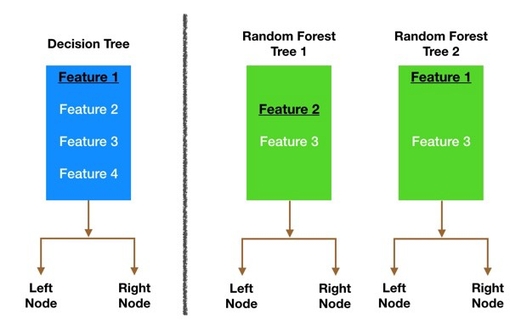
Random Forest: Random subsets of features
Only a subset of all the features are considered for splitting each node in each decision tree.
Generally this is set to sqrt(n_features) for classification meaning that if there are 16 features, at each node in each tree, only 4 random features will be considered for splitting the node.
Lectures: Does random forest select a subset of features for every tree or every node?

Slide 16
Idea principal sobre RF
Random Forest es el resultado de múltiples árboles que NO correlacionan entre sí.

Slide 17
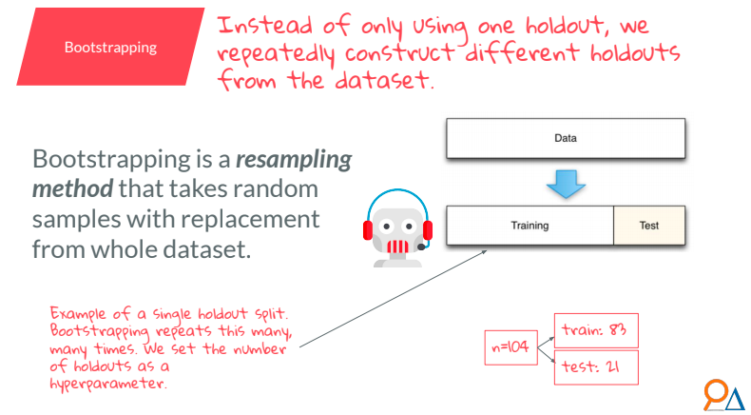
Bootstrapping

Slide 18
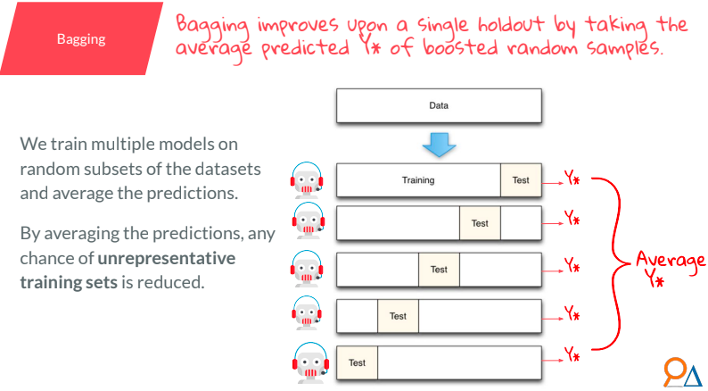
Bagging

Slide 19
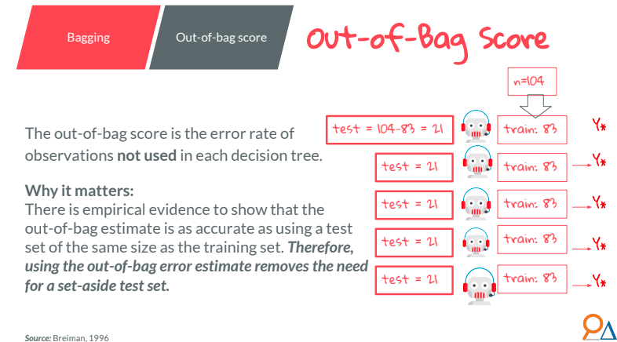
Out-Of-Bag

Slide 20
Gradient Boosting Machines
Like Random Forests but….
Not so random….
Notes:
Esta la quito igual

Slide 21
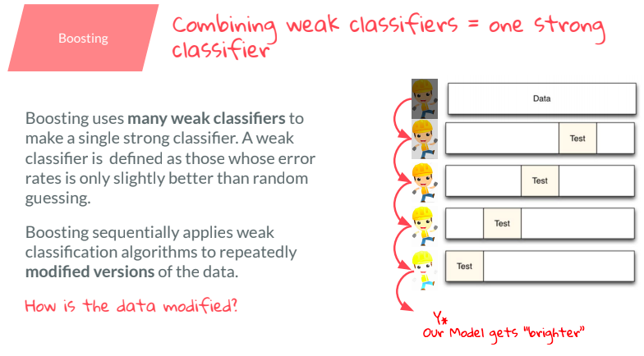
Boosting

Slide 22
Gradient Boosting Machines
Train 1 tree as in Random Forest
<
Notes:
Esta la quito igual

Slide 23
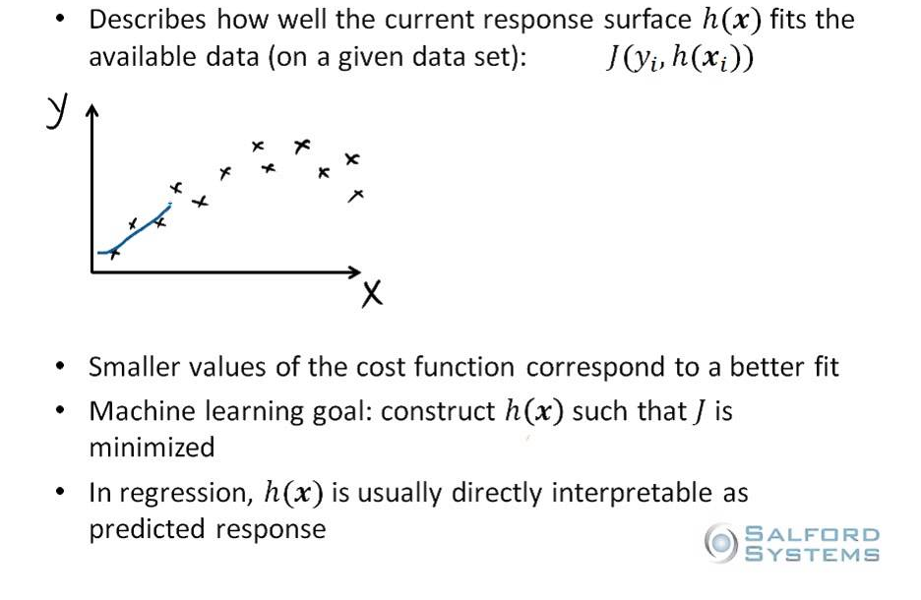
Gradient Boosting Machines
Calculate cost function
Notes:
Esta la quito igual

Slide 24
Gradient Boosting Machines
For which data points is the tree performing worst?
Give more importance to these data points when making the next tree
Train 2nd tree considering importance
Notes:
Esta la quito igual

Slide 25
Gradient Boosting Machines
For which data points is the combination of the two trees performing worst?
Give more importance to these data points when making the next tree
Train 3rd tree considering importance
Notes:
Esta la quito igual

Slide 26
Gradient Boosting Machines
Repeat with many more trees
Notes:
Esta la quito igual

Slide 27
Gradient Boosting Machines
Available algorithms:
XGBoost
CatBoost
AdaBoost
LightGBM
....
Notes:
Esta la quito igual

Slide 28
XGBoost
The fastest kid in town
Usually better results than plain random forest
Notes:
Esta la quito igual

Slide 29
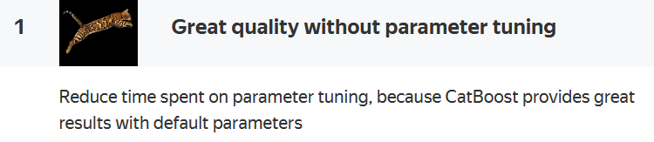
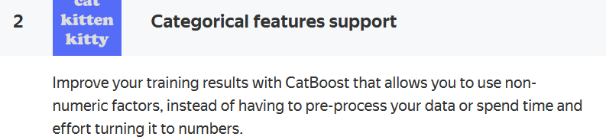
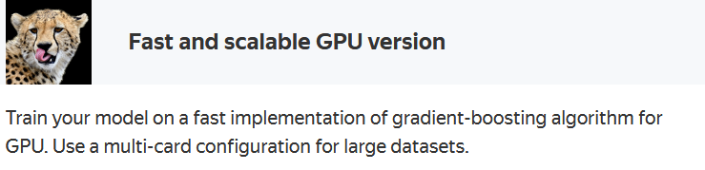
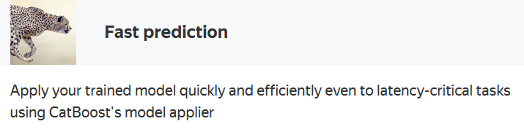
CatBoost
Last one to join the party
Great with categorical features
Notes:
Esta la quito igual

Slide 30
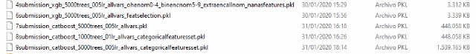
Comparison of models
Accuracy:
4 - 0.78172
6 - 0.78129
7 - 0.78261
8 - 0.78441
9 - 0.78452
Notes:
Esta la quito igual

Slide 31
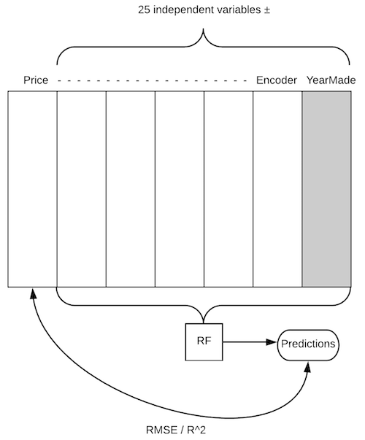
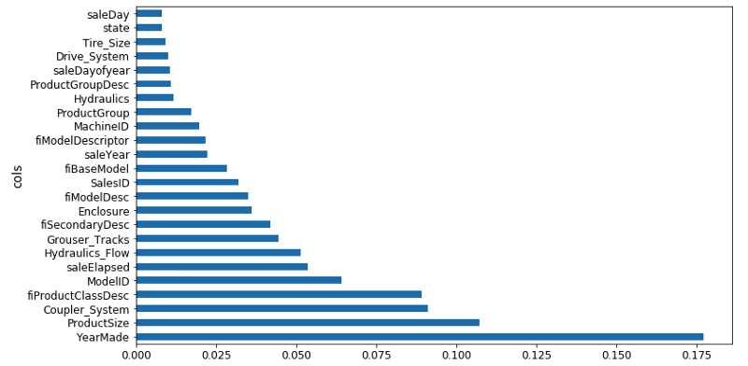
Plotting & Feature Importance
Queremos ver qué “features” hacen “puro” nuestro dataset, son las más relevantes.

Slide 32
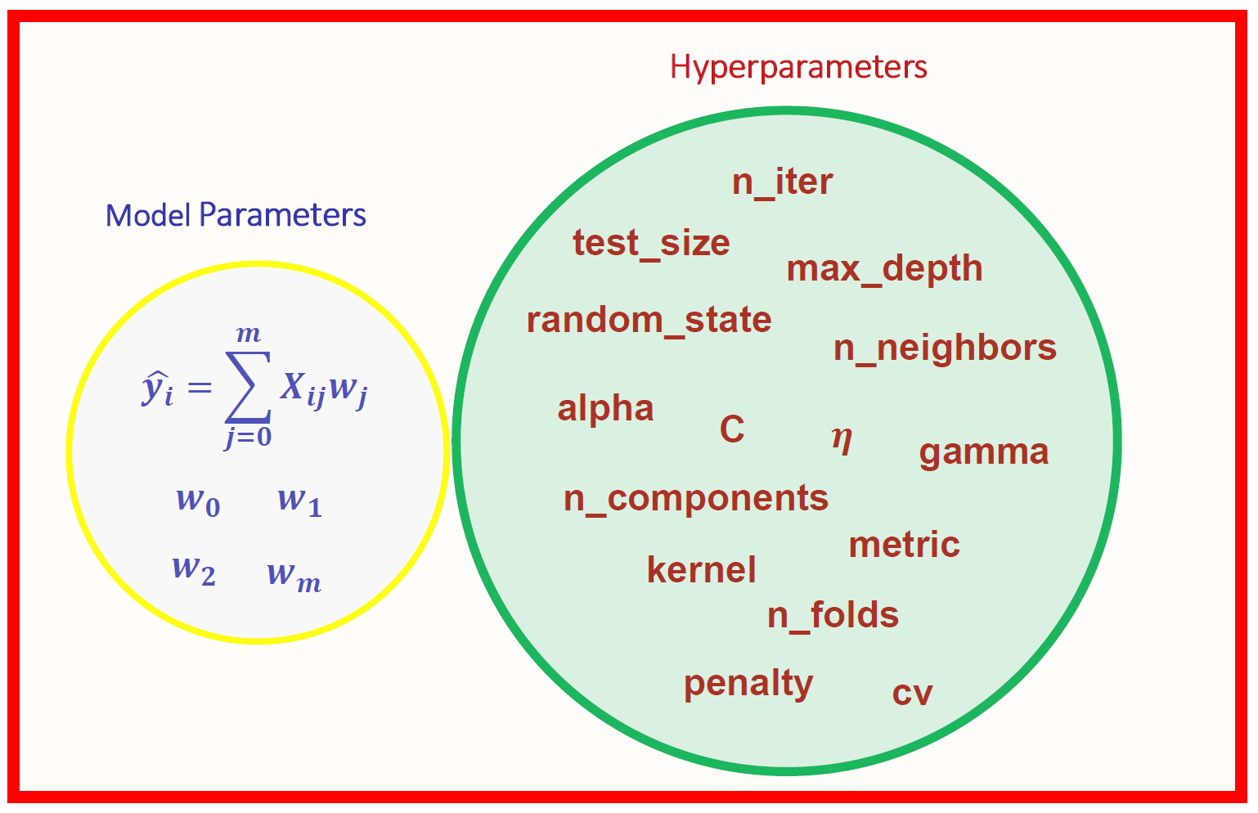
Hyperparameter Tunning
More info: [1]

Slide 33
Feature Engineering
Hiper-parámetros: la manera de ajustar nuestros modelos
Feature Importance: determinando los factores más influyentes de nuestro data, cómo visualizarlo y representarlo, además de solucionar un error de la lesson pasada en materia de sorting.
One-Hot Encoding: cómo lidiar con datos categóricos de manera eficiente
Remove redundant features: haciendo nuestro dataset más “puro” y, a veces, quitando lo superfluo se obtienen mejores resultados (menos varianza)
Partial dependent: variables que en ciertas condiciones pueden estar condicionando otras de manera no-relacional (ej. valores por defecto)
Tree interpreter: cogiendo trees uno por uno y disecando predicciones per-row y per-tree. ¿Qué trees y en qué rows proporcionan una mayor eficacia/precisión?
Cross-validation: usando todo el dataset como test y training al mismo tiempo (ventajas y desventajas)

Slide 34
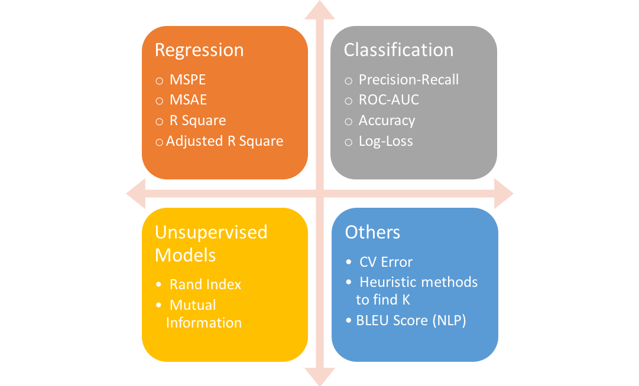
Classification vs. Regression Evaluation
More info: [1] [2]

Slide 35

Challenge!

Slide 36
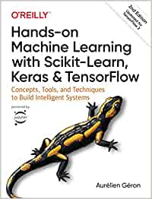


Bibliografía
/1./ /Hands-on Machine Learning with Scikit-Learn, Keras, and TensorFlow/
/2./ /Fast.AI - Introduction to Machine Learning for Coders/
/3./ /MLCourse.AI/
/4./ /DeltaAnalytics/
/5./ /The Hundred-page Machine Learning Book/
/6./ /Machine Learning for Humans (Vishal Maini)/
/7./ /Datacamp/
/8./ /DataQuest/

Slide 37

WI-FI
Wi-Fi
LOOM_Guest -> Bienvenidos!
LOOM Princesa -> LoomPr1nc3sa
madrid@saturdays.ai

Slide 38








Gracias a nuestros partners por ayudar a Saturdays.AI a salvar la brecha de habilidades de la 4ª revolución industrial, acercando la IA a todo el mundo.

